Slide 1
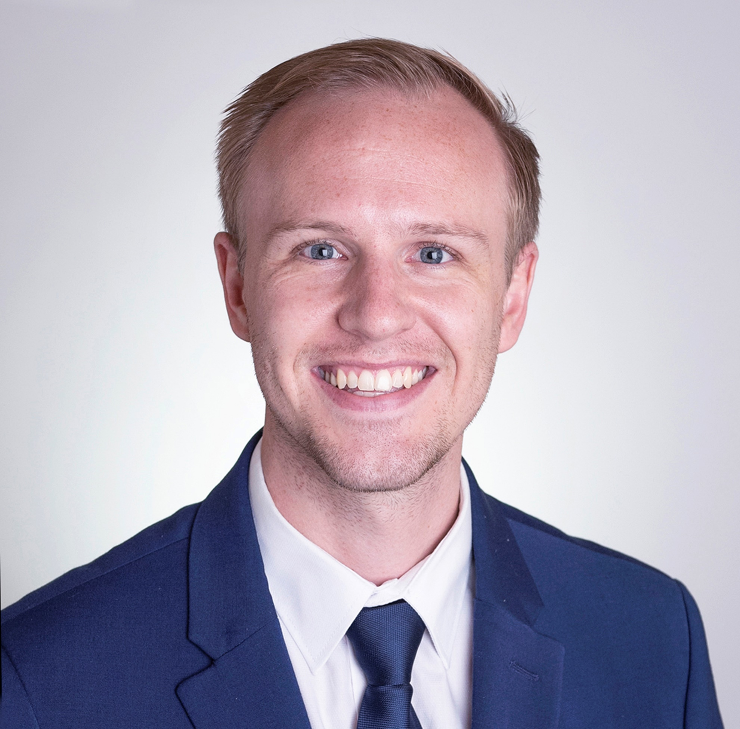










Charl L. Brill
LinkedIn Profile
Kaggle Profile
Johannesburg, South Africa
GitHub Profile
charlbrill@gmail.com
072 408 3988
CAREER OBJECTIVE
An experienced consultant who combines a systems thinking mindset (engineering) with critical reasoning skills (MBA). Driven by the need to use data, analytics and strategic reasoning to ensure evidence-based decision making for future generations.
PROFESSIONAL PROFILE
Engineer by trade, problem solver by passion
Fuelled by an incredible passion for obtaining knowledge and applying heuristic solutions to complex problems, supported by strong data analysis for evidence-based decision making.
Pursued mechanical engineering to establish a foundation for understanding and approaching complex problems systematically, by breaking them down into key components.
Extended this pragmatic solutions mindset to a boutique management consulting firm
Exposure to projects within industries including logistics, operations, corporate finance and accounting (specifically budgeting).
SKILLS
Data analytics/ Statistics
Strategy design and Problem Solving
MS Office
Operational efficiency optimisation
Project management
Data Science
BI stack (PowerBI, Qlik, Tableau)
Process/data flow design
Product management
Alteryx CORE certified
Neural Networks
KNIME
Python, limited R
INDUSTRY EXPOSURE
Engineering and Design
Financial services, Banking
Retail
Logistics and supply chain
Property development
Manufacturing

Slide 2


CAREER SUMMARY
AgrigateOne
Data Scientist, August 2020 to present
Managed the data team which was focussed on Data Analytics (dashboard and BI development using Metabase) and Data Science projects (process automation and predictive modelling)
Responsible for product roadmaps of key features relating to data analytics and data science
Developed several BI dashboard reporting solutions, which is a core feature of the platform
Decision Inc.
Business Intelligence Consultant, April 2019 to July 2020
Advanced Analytics – co-led the Advanced Analytics team within DI (Alteryx, KNIME, Python)
Examples of analytics projects:
Operations injury driver analysis (mining) (Regression analysis)
Sales forecasting (Timeseries forecasting), procurement spend analysis
Demand planning (retail logistics) and stales analysis (Timeseries analysis)
Data Strategy Design – aligning corporate strategy with data management and IT strategy
BI model development (PowerBI, Qlik Sense and QlikView)
Burlington Strategy Advisors
Analyst, July 2014 to September 2017
Led the creation of a financial model, which forecasts the cashflows for a property development.
Developed a techno-financial model for a large scale engineering project that focused on a trigeneration (heated water, chilled water and electricity generation) service solution.
Designed and developed a capital portfolio optimisation solution for one of the largest capital portfolios in South Africa, at the time.
Mintek
Project Engineer, January 2013 to June 2014
Led the design office within Mintek and managed new projects focussing on the design of new equipment for pilot plants and site layouts
ACHIEVEMENTS AND AWARDS
Top achievement for Entrepreneurship during MBA 2019
Overall top postgraduate diploma (GM) student award at GIBS 2018
Top student performance for 5 (out of 12) PGDip (GM) courses at GIBS 2018
Achieved a GMAT score of 670 (82nd percentile at time of writing the exam) 2017
Shooting Star award for “exemplary performance” on a project 2016
Graduated 2nd in Mechanical Engineering class 2012
Participant of the International Scholar Laureate Programme (ISLP) (Engineering delegation), China 2011
Top Engineering student (Mechanical) 2010

Slide 3



EDUCATION
Master of Business Administration and Post Graduate Diploma (General Management)
GIBS, University of Pretoria, 2017 to 2019
Master of Business Administration (MBA) – 70% average
PGDip (General management) – 78% average
Attended a term abroad (Kelley School of Business – Indiana University, USA) (2 months)
Completed subjects in New Product Management, Predictive Analytics and Data Mining and International Business Environment
Thesis topic: The influence of management support on the drivers of business intelligence success (published online here)
Bachelor of Engineering, Mechanical (Cum Laude)
Stellenbosch University, 2009 to 2012
Achieved an average of 80.2%
Second in graduating class
National Senior Certificate (IEB)
Helpmekaar College, 2005 to 2008
Passed with 9 distinctions (A) (90% average)
Equivalent GPA of 3.5
INTERESTS
Data Science news
Technology disruption
Travelling
Movies and series
The future of technology
Kaggle competitions in Python
CrossFit
Good food
Reading (Business, Psychology, Science)
REFERENCES
1. Mr. Peter Gaertner
Senior BI consultant (Decision Inc.)
Mobile: +27 72 626 6120
E-mail: pe.gaertner@gmail.com
2. Mr. Chris Fleming (character reference) Intermediate BI Consultant (Decision Inc.)
Cell: +61 402 254 723
E-mail: howzitchris@gmail.com

